Slide 1
Student life
Survey

Slide 2
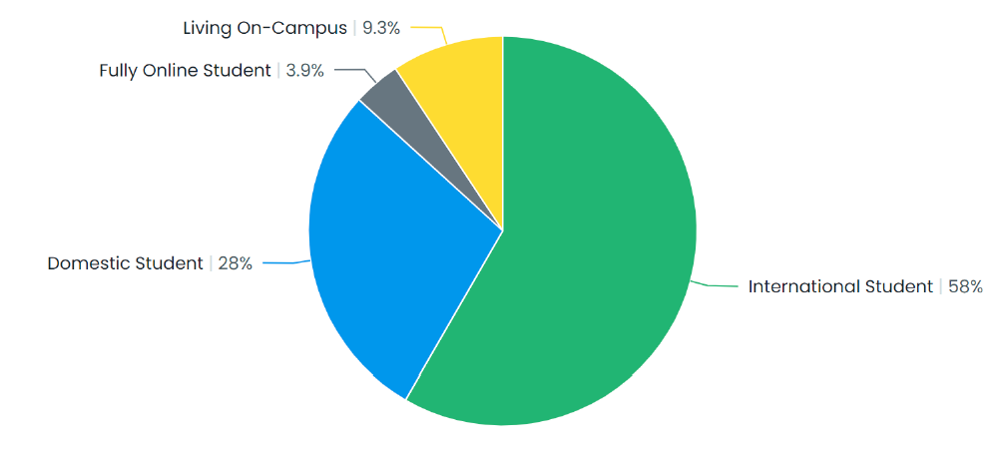
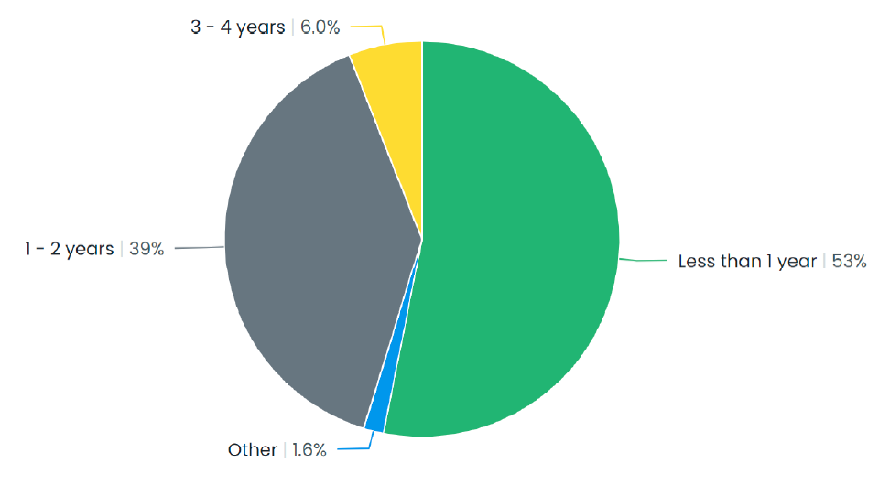
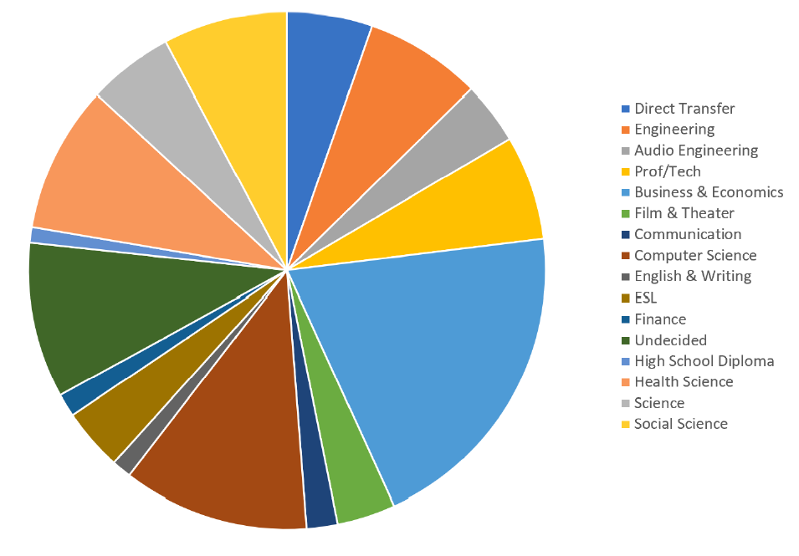
Survey date: 11/14-1/31
367 responses

Slide 3
Topics addressed
Engagement interest/availability
Communication methods
On-campus jobs
Food service & coffee
Library & Learning Center hours
E-line shuttle
Game Room
Financial resources

Slide 4
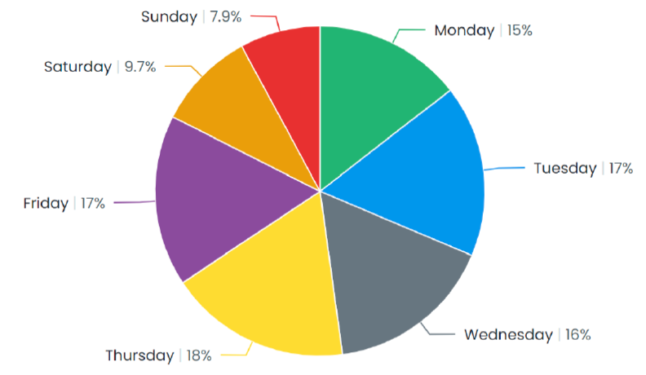
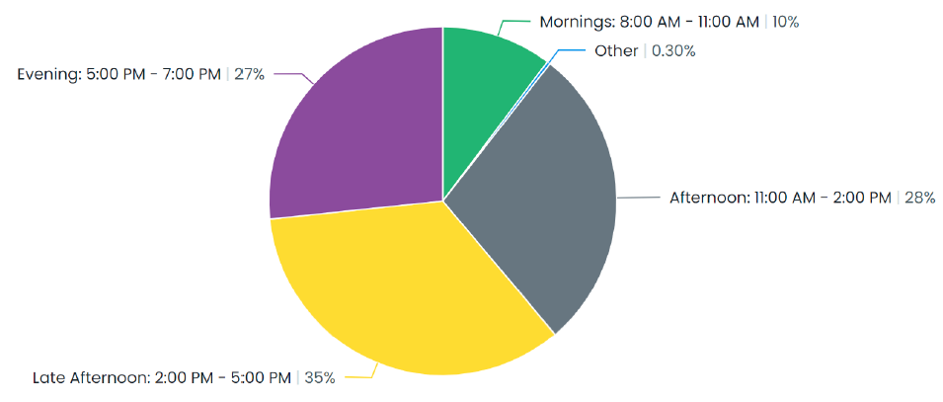
Engagement availability

Slide 5
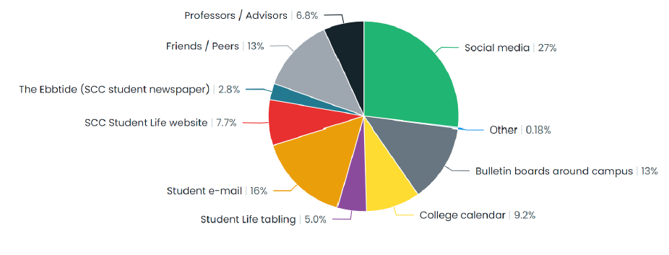
Communication Methods

Slide 6
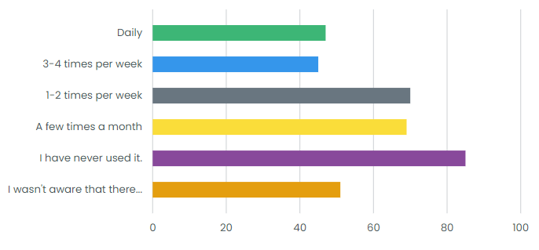
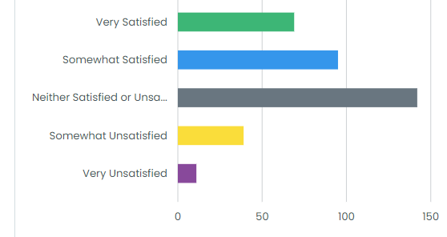
Food services feedback
Current use of avanti grab & Go
Satisfaction with avanti grab & Go

Slide 7
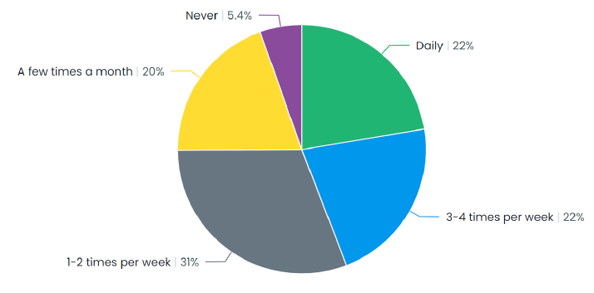
Food services feedback
Interest in hot food if served on campus

Slide 8
Sample food services feedback
“Allergen friendly options plus dairy and gluten free would be awesome”
“I wish it were less expensive.”
“More variety of foods. I do really appreciate this though!”
“The price is a bit high and oftentimes the fridges are empty. I hope the fridges could be refilled more often.”

Slide 9
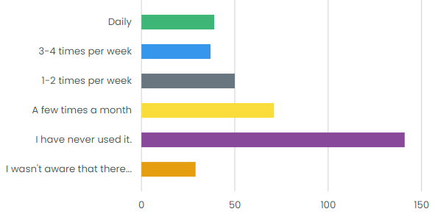
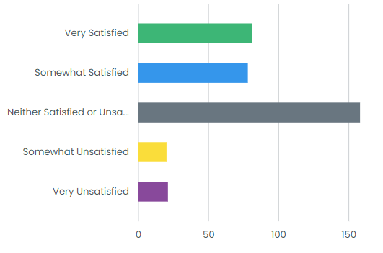
Coffee feedback
Current use of pub coffee machine
Satisfaction with pub coffee machine

Slide 10
Sample coffee feedback
“I have never used it before.”
“Usually one or both machines are not working. I guess improving the reliability of the machines.”
“I would like to see an actual coffee shop with real people working there, not some robot who messes up my order every time.”
“More creamer choices please (liquid, dairy free, etc.)”

Slide 11
Sample student feedback
“The limited hours for the library and bookstore are really challenging for anyone who works full-time. (Which is a good share of community college students). I had to take a day off work to pick up my books I had ordered because the bookstore isn't open a single day or hour that I don't work. I have never even been in the library.”
“I would like to advocate to fix the sauna in the women's gym locker”
“I wish the school gym can open everyday”

Slide 12
Sample student feedback
“Y’all main concern should be food on campus. Most of the community colleges in the area have food trucks and such. SCC is behind in the food department. Food makes everyone happy.”
“really enjoy activities and that the college provides but having more sessions of the same activities might be better since some days I don't have class (which I wont come to the college) or the session is during my class time. I also interested if there are activities where college students go out (eating or to the park). Especially when international students are not familiar with the area.”

Slide 13
Any
Questions?

