Slide 1

Uploading an Accommodated Exam in Your
Instructor AIM Portal
Student Accessibility Services (SAS)

Slide 2
Notification of Exam Request
When a student submits an exam requests via AIM, you will immediately receive an email notification via your Shoreline email. The email will include:
Student name and SID
Class
Exam Type
Date of exam as requested by student
Start Time for exam as requested by student
Standard Length of Exam (without accommodations)
End Time (with accommodations)
Location will state “TBD” as the SAS office will not yet have assigned a room.
Most importantly: there will be a link for you to upload a digital copy of your exam.

Slide 3
Exams and Instructions
At the bottom of the notification email, you will see the following text:
Please upload a digital copy of your student's exam using https://elbert.accessiblelearning.com/Shoreline/ExamFile.aspx?ID=E79589837146970&Key=4RCJ2mXI. Please also submit instructions about this exam via your Instructor AIM Portal.
Note that the link to upload your exam will be unique (not the same as the one above).

Slide 4
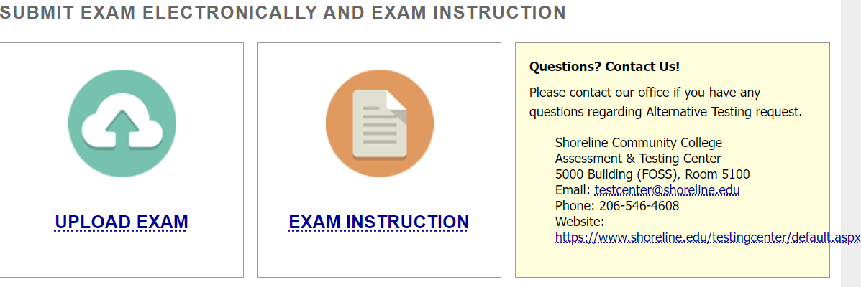
Upload Exam and Instructions
Click the link provided in the notification email. This will take you directly to your Instructor AIM Portal.
You will see a link to upload the exam and a link to provide instructions.
Be sure to upload your exam a minimum of two business days before the exam date.

Slide 5
Frequently Asked Questions
Question: Do I have to resubmit the same test over and over?
Answer: No. If it is the same test, for the same time, you can note that it is “Same Exam For Everyone” when you upload it. The system will keep that test for any student in the class testing at that time.
Question: Can I add extra instructions?
Answer: Yes. The instructions have premade questions as well as a section where instructors can add additional notes.
Question: My student submitted an exam request but my tests are going to be online with students testing at home. Do I need to go through this process?
Answer: No. Simply ensure that your students are receiving their other accommodations. We ask also that you remind your students to cancel their exam room requests.

Slide 6
If You have Questions or Need Assistance
Contact the Assessment & Testing Center using one of the methods below:
Email at: testcenter@shoreline.edu
Call: 206-546-4608

