Slide 1
Introduction to
Title IX at Shoreline CC
Presented by
Tricia Lovely
Title IX / EEO Coordinator

Slide 2
Today’s session
Learning goals
Review of Title IX
Our roles and responsibilities
Responding to reports of sexual misconduct
Apply your knowledge

Slide 3
Learning goals
By the end of this session, you will…
Be familiar with the basics of Title IX
Understand our responsibilities under Title IX as a college and as individual employees
Know how to respond to a report of sexual misconduct

Slide 4
Why are we here today?
Students and employees who are affected by sexual misconduct can face significant barriers to education and productive employment
Anxiety
Depression
Increased use of drugs and alcohol
General life disruption

Slide 5
Why are we here today?
The way we respond to a report of sexual misconduct can mean the difference between someone dropping out of school or leaving their job or receiving the help and support they need to recover and complete their education or remain employed at SCC.

Slide 6
What is Title IX?
“No person in the United States shall, on the basis of sex, be excluded from participation in, be denied the benefits of, or be subjected to discrimination under any education program or activity receiving federal financial assistance.”
Education Amendments of 1972

Slide 7
In other words…
Title IX Requires gender equity in education programs, athletics and activities in schools, public and private, that receive federal funding.
Almost all colleges and universities in the U.S. receive some type of federal funding.
Notes:
Title IX is often associated with athletics, because it began as way to ensure equal opportunities for male and female students to participate in athletic programs. It has since come to encompass every aspect of education in the United States.

Slide 8
What does Title IX do?
Prohibits gender discrimination
Prohibits sexual harassment
Prohibits sexual violence
Prohibits discrimination against pregnant and parenting students and staff

Slide 9
Definitions
Gender Discrimination
Unfavorable treatment of a person based on that person’s sex, gender identity, sexual orientation or pregnancy. Prohibited gender-based discrimination includes sexual harassment.

Slide 10
Definitions
Sexual Harassment
A form of discrimination consisting of unwelcome, gender-based verbal, written, electronic and/or physical conduct.

Slide 11
Definitions
Sexual Harassment
Two types under Title IX:
1. Quid Pro Quo: A school employee conditioning the provision of an aid, benefit, or service of the school on an individual’s participation in unwelcome sexual conduct

Slide 12
Definitions
Sexual Harassment
2. Hostile Environment: Unwelcome conduct that a reasonable person would find to be so severe, pervasive, and objectively offensive that it effectively denies a person equal access to the College’s educational programs or activities or College employment.

Slide 13
Definitions
Sexual Violence
Includes:
Nonconsensual sexual contact
Nonconsensual sexual intercourse
Domestic violence
Dating violence
Stalking

Slide 14
Title IX Requires the College to:
Respond promptly and effectively when a possible Title IX violation becomes known
Provide supportive measures to involved parties as needed
Investigate formal complaints
Ensure due process and fair treatment of all parties in our response
Provide remedies to restore access to education – disciplinary action, supportive measures, etc.
Protect all parties from retaliation

Slide 15
What is our role as employees?
As representatives of Shoreline CC, we support a culture of care for each other and our students.
We commit to creating an environment in which sexual misconduct is unacceptable
We serve as mandated reporters.

Slide 16
Who is a mandated reporter?
With the exception of Counselors,
We are all mandated reporters
If you witness or learn about sexual violence, sexual harassment or gender discrimination, you must report it to an appropriate authority (Title IX Coordinator, supervisor or Dean, Safety and Security).

Slide 17
How do I respond?
When someone reports sexual misconduct
1. Determine if emergency services are needed (medical treatment or law enforcement response). If so, call Safety and Security.
2. Help the person feel safe and supported
3. Let them know that you may not be able to keep what they tell you confidential.

Slide 18
How do I respond?
When someone reports sexual misconduct
4. Suggest they visit the Counseling Center if they wish to speak with someone confidentially. Accompany them if you can.
5. Listen for understanding. Set aside judgment.
6. Report the concern!

Slide 19
Privacy vs. Confidentiality
The difference is important!
Confidentiality means you tell no one (with very few exceptions).
Privacy means you tell only the people who need to know in order to keep the community safe and investigate the complaint.
Unless you are employed by SCC as a Counselor, you cannot promise confidentiality.

Slide 20
Keep in mind
A survivor of sexual violence may be experiencing trauma. Trauma can show up in many different ways:
A person may be overwhelmed by emotion, or may show no emotion at all
Their story may not seem plausible or make sense
You don’t need to decide if their story is true. Just support them and report what you know.

Slide 21
How do I report a concern?
In the case of a life-threatening emergency, call 911.
If a situation requires immediate attention, call Safety and Security - 206-235-5860 (24/7/365).
If the situation is not urgent:
Contact the Title IX Coordinator
File a report online (https://www.shoreline.edu/title-ix/)
Tell your supervisor or Dean
All of the above!

Slide 22
After you report a concern
The Title IX Coordinator contacts the complainant to get more information and determine next steps
Supportive measures will be arranged as needed (referrals to campus and community resources, academic accommodations, housing accommodations if needed, etc.)

Slide 23
After you report a concern
The Title IX Coordinator will identify the appropriate path to resolution
Informal resolution: supportive measures, agreement among the parties
Formal resolution: full investigation, finding of responsibility, possible disciplinary action

Slide 24
Supportive measures are key
Examples include:
Moving a student to another section of a class
Allowing student to withdraw from a class without negative repercussions (academic or financial)
Adjusting assignment deadlines
Not assigning students to the same group
Allowing a student to leave class a few minutes early

Slide 25
Investigations
What you need to know:
Investigators are employees who have received special training
You may be asked to come in for an interview and/or submit a written statement
Investigations take time (usually 2 months or more)
Regardless of the path to resolution, you may never know the outcome.

Slide 26
Creating a culture of care
Know about campus resources – Counseling Center, Safety & Security, Title IX Coordinator
Be familiar with College policy and Title IX grievance procedures
Include language on your syllabus or department web page about Title IX
Be an active bystander

Slide 27
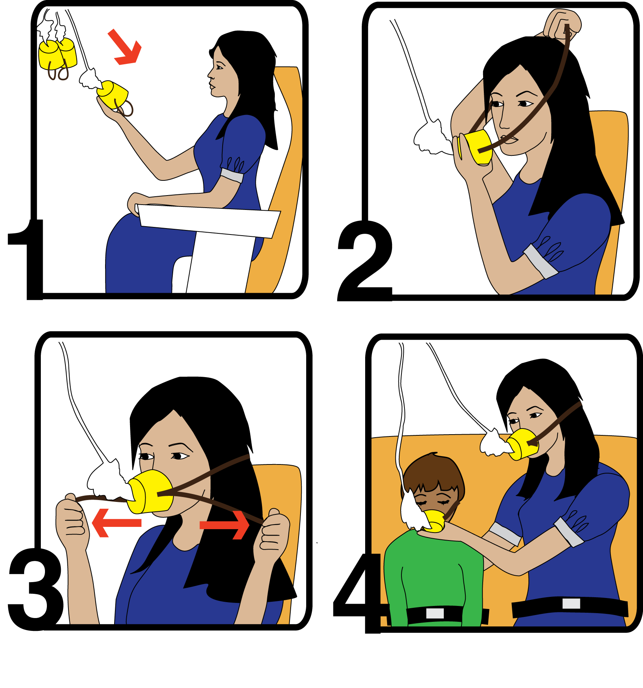
Take care of yourself!

Slide 28
Putting it all together…
Scenario 1:
A student tells you that another student has been bothering them – asking them out repeatedly, hugging them, waiting for them after class. They are beginning to feel uncomfortable, but they tell you they don’t want to make a big deal of it.
How will you respond?
How is the college likely to respond?

Slide 29
Putting it all together…
Scenario 2:
You notice a student’s level of participation in class has changed and their grades have slipped. When you reach out to them, they disclose that their partner has physically and verbally abusive.
How do you respond?
How is the college likely to respond?

Slide 30
Conclusion
Did we accomplish the learning goals?
Did you learn the one thing you wanted to learn today?
Is there anything else you would like to discuss today?

Slide 31
Learn more:
Shoreline CC Title IX web page:
https://www.shoreline.edu/title-ix/
U.S Department of Education:
https://www2.ed.gov/policy/rights/guid/ocr/sex.html
American Association of University Women (AAUW):
https://www.aauw.org/title-ix/

Slide 32
Contacts
Tricia Lovely
Title IX/EEO Coordinator
tlovely@shoreline.edu
206-533-6746
Counseling Center
206-546-4594
Campus Safety and Security (24x7)
206-235-5860 (campus extension 4499)

Slide 33
Thank you for your time!

